Slide 1
Getting Started with SharePoint Framework Extensions
Introduction to Extensions & Application Customizers

Slide 2

Introduction to Extensions & Application Customizer
SPFx Extensions
Debugging & Testing Extensions
Deploying Extensions
Application Customizers
Notes:
In this unit, you'll learn what SharePoint Framework extensions are and how you can use them to customize SharePoint. Then, you'll learn about one type of extension: application customizers.

Slide 3
SharePoint Framework Extensions
Extend the SharePoint user experience
Customize notification areas, toolbars & list data views
Available in Modern pages, lists & libraries
SharePoint Online
SharePoint Server 2019
Used to implement popular customizations from previous development models
Delegate controls & ScriptLink
Client-Side Rendering & JSLink
Custom Actions
Notes:
SharePoint Framework extensions enable developers to customize and extend the SharePoint user experience. You can use them to customize notification areas, list toolbars, list menus, and list data views.
Microsoft introduced extensions in the SharePoint Framework to allow customers to implement some of the same customization options available in classic sites. Extensions will only work in the modern SharePoint experience and are intended to serve as the modern option for the following options in the classic experience:
- delegate controls and `ScriptLink`
- client-side rendering (CSR) and `JSLink`
- custom actions
Because they only run in the modern experience, you can only use SharePoint Framework extensions in SharePoint Server 2019 and SharePoint Online.

Slide 4
Application Customizers
Add HTML or JavaScript to all pages in a SharePoint site
Similar to pre-SPFx / classic mode customizations
Delegate control
ScriptLink control
Example scenarios
Add script to every page
Add 3rd party libraries to every page (ie: Azure Application Insights)
Add notice to all pages such as: alerts, news or privacy
Notes:
Now let's look at one type of SharePoint Framework extension: the application customizer. Application customizers enable you to do two things:
- add script to all pages in a site collection
- set the HTML on two well-known `<div>` elements on the page that serve as headers and footers
This type of extension is intended to be the modern experience replacement to the classic experience's delegate control and `ScriptLink` control. Some common uses for application customizers include the following:
- **add script to every page**: If you need to add JavaScript to all pages in your site, the application customizer is perfect for this scenario.
- **add third-party libraries to all pages in a site**: Similar to the previous scenario, you can use an application customizer to install a third-party service or library for monitoring or telemetry tracking in a site, such as Azure's Application Insights. The application customizer is used to add the necessary reference to the JavaScript library to all pages and do any required configuration.
- **add notice to all pages**: Application customizers are used to add script to a page. You can use this approach to display news, privacy messages or alerts to all your users easily using application customizers.

Slide 5
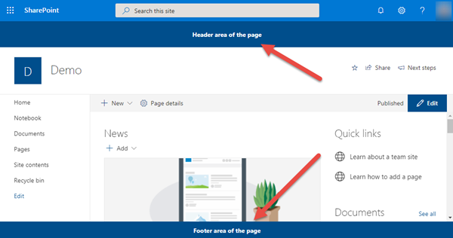
Application Customizer - Placeholders
Two well-known placeholders exist on all pages
Header (just below Office 365 suite bar)
Footer (bottom of page)
Placeholders are sticky & always visible
Notes:
In addition to adding script to all pages, application customizers also enable developers to add HTML to two well-known elements on all pages in a site.
These two elements, called *placeholders*, are located at the top and bottom of a page. The top placeholder is a `<div>` that spans the entire top part of the page just below the Office 365 suite bar.
The bottom placeholder acts as a footer. This `<div>` spans the width of the page.
Both placeholders are sticky in the sense they remained pinned in the browser and don't scroll with the page.

Slide 6
Application Customer
export interface IHelloAppCustomizerApplicationCustomizerProperties {
prefixString: string;
}
export default class HelloAppCustomizerApplicationCustomizer
extends BaseApplicationCustomizer<IHelloAppCustomizerApplicationCustomizerProperties> {
private _topPlaceholder: PlaceholderContent | undefined;
private _bottomPlaceholder: PlaceholderContent | undefined;
@override
public onInit(): Promise<void> {
// this is where you do your work
}
private _onDispose(): void {
}
}
Notes:
To write to a placeholder you must first get a reference to it from the application customizer. In this code, notice the two private members `_topPlaceholder` and `_bottomPlaceholder`. You should always first check if you have a reference to the placeholder before writing to it. Otherwise, you can run into errors as you can't have more than one reference to it.
Obtain a reference to the placeholder with the `placeholderProvider` object by calling `this.context.placeholderProvider.tryCreateContent()` method.

Slide 7
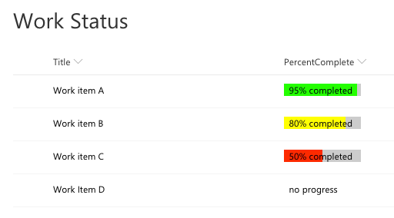
Field Customizers
Customize rendering of a list column in modern lists
Notes:
The next type of extension is the field customizer. This extension is intended to be the modern replacement to the legacy client-side rendering (CSR) framework and `JSLink`.
Field customizers enable you to define the HTML within a cell in a list view. In the following screenshot, notice the **Percent Complete** column is rendered with custom colored bars instead of plain text:

Slide 8
Field Customizer
Customize of a field in a SharePoint list view
Similar to pre-SPFx / classic mode customizations
Client-Side Rendering (CSR)
JSLink
Example scenarios
Display picture or illustration in field instead of text
Make a field rendering interactive
Add React component to field rendering
Notes:
A SharePoint Framework field customizer extension enables developers to customize the of a field in a SharePoint list view. These extensions are similar to the SharePoint classic experience customizations of client side rendering (CSR) and JSLink. The classic mode customizations of CSR and JSLink don't work in the modern experience and field customizers will only work in the modern experience.
A field customizer enables a developer to define through code how a specific column should be rendered when a user views a SharePoint list in the grid-view format in the modern experience. The following scenarios are some example use cases for field customizers:
- display a picture or illustration in a field instead of text
- make renderings interactive
- add React component to a field rendering.

Slide 9
Field Customizer Class
export interface IPercentCompleteFieldCustomizerProperties {
yellowMinLimit?: string;
}
export default class PercentCompleteFieldCustomizer
extends BaseFieldCustomizer<IPercentCompleteFieldCustomizerProperties> {
@override
public onInit(): Promise<void> {
}
@override
public onRenderCell(event: IFieldCustomizerCellEventParameters): void {
// called when rendering the cell
}
@override
public onDisposeCell(event: IFieldCustomizerCellEventParameters): void {
}
}
Notes:
The implementation of a field customizer is similar to the other SharePoint Framework extension options.
An interface is used to define the public properties that can be set as inputs on the extension.
The extension is implemented in a class that extends the `BaseFieldCustomizer` class. This class contains three methods you can override:
The `onInit()` method returns a `Promise` object and can be used to perform any initialization code that need to be completed prior to rendering the field customizer. Once the returned promise resolves, the SharePoint Framework will call the `onRenderCell()` method.
The `onRenderCell()` method receives a single parameter of type `IFieldCustomizerCellEventParameters` that developers can use to obtain the value of the field for the current list item and modify the contents of the cell associated with the field.
The last method, `onDisposeCell()`, is called by the SharePoint Framework when the field is removed form the page. You should use this method to clean up any references or handlers you've setup in either the `onInit()` or `onRenderCell()` methods.

Slide 10
Deploying Field Customizers as a Site Column
<Field ID="{0ebe7606-20f4-49be-bcdc-2dfc65348b46}"
Name="PercentageComplete"
DisplayName="Percentage Complete"
Type="Number"
Min="0"
Required="FALSE"
Group="SPFx Columns"
ClientSideComponentId="fcedd96a-1c34-4ac8-9ad8-5aaf4cb1e993"
ClientSideComponentProperties= "{&quot;greenMinLimit&quot;:&quot;85&quot;,&quot;yellowMinLimit&quot;:&quot;70&quot;}">
</Field>
Notes:
Field customizers are deployed to SharePoint as new site columns. To associate a field customizer with a site column defined with the declarative option using the `<Field>` element, set the `ClientSideComponentId` property to the unique ID of the field customizer component define in it's manifest file. SharePoint will load the installed field customizer on the page when a list containing the site column is displayed on the page.
> [!IMPORTANT]
> You must ensure that the field customer is installed in a site wherever the site column is used.
Developers can set the public properties on the field customizer using the `ClientSideComponentProperties` property on the site column's `<Field>` element. The value of this property should be set to a XML encoded JSON string of the properties.
You can also add a field customizer to site column programmatically by setting properties `ClientSideComponentId` and `ClientSideComponentProperties` are available on the `Field` object.

Slide 11
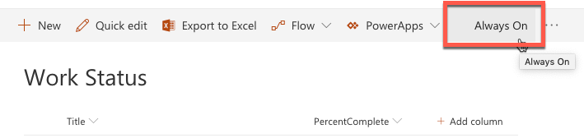
Command Sets
Add buttons to list & library toolbars & context menus
Notes:
The last type of extension is the command set. This extension is intended to be the modern replacement for legacy custom actions.
Command sets enable you to add buttons to list and library toolbars or to the context menu of items within a list.

Slide 12
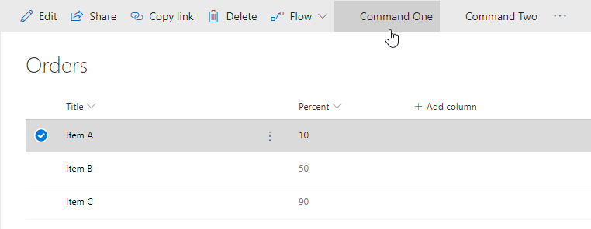
List View Command Sets
Add buttons to modern lists & libraries
Add to toolbar
Add to item context menus
Or both!
Control visibility state of button based on state of view
Similar to pre-SPFx / classic mode customizations
Custom actions
Example scenarios
Start external process
Execute custom script when clicked
Notes:
A SharePoint Framework command set extension enables developers to add buttons to modern lists and library toolbars and context menus.
Each button's visibility state is controlled using a single boolean property that developers can set. This property enables developers to conditionally show or hide buttons from the toolbar or context menus on an item. These command set extensions are similar to the SharePoint classic experience customizations of custom actions. The classic mode custom action customizations don't work in the modern experience and command sets will only work in the modern experience.
The following scenarios are some example use cases for command sets:
- start an external process
- execute custom script when the button is selected
The SharePoint Framework will raise an event whenever the state of the view changes that your custom code can subscribe to. For example, if a user selects or unselects an item or changes a filter on the view, you can conditionally change the state of the button's `visible` property based on how many items are currently selected in the list.

Slide 13
Defining Command Set Buttons
// *.manifest.json
{
"items": {
"ONE_ITEM_SELECTED": {
"title": { "default": "One Item Selected" },
"iconImageUrl": "icons/request.png",
"type": "command"
},
"ALWAYS_ON": {
"title": { "default": "Always On" },
"iconImageUrl": "icons/cancel.png",
"type": "command"
}
}
}
Notes:
Unlike the other types of extensions, you must first register the command set buttons prior to executing the code. Command set registration is done in the component's manifest file. Each button must be added to the `items` collection:
This JSON excerpt from the component manifest registers three buttons. The name of the buttons must be in all caps and only consist of letters and underscores.
Each button reference has a `type` property set to `command` and a `title` property that can be localized to any of the SharePoint Framework supported locales.

Slide 14
Command Set Class
export interface ICommandSetDemoCommandSetProperties {
messagePrefix: string;
}
export default class CommandSetDemoCommandSet
extends BaseListViewCommandSet<ICommandSetDemoCommandSetProperties> {
@override
public onInit(): Promise<void> {
}
@override
public onListViewUpdated(event: IListViewCommandSetListViewUpdatedParameters): void {
// fired when state of list view changes
}
@override
public onExecute(event: IListViewCommandSetExecuteEventParameters): void {
// what happens when button is selected
}
}
Notes:
After registering the buttons, you must create a class who's implementation is similar to the other other SharePoint Framework extension options.
An interface is used to define the public properties that can be set as inputs on the extension.
Next, implement a class that extends the `BaseListViewCommandSet` base class and override the implementation of three methods:
The `onInit()` method returns a `Promise` object and can be used to perform any initialization code that needs to be completed before rendering the command set.
Next, implement the `onListViewUpdated()` event. This method is called when the command set button is first rendered on the page and when the list view state changes. Each button rendered on the page will call this method, so if you have registered three buttons in your component's manifest, this method will be called three times every time the list view state changes.
The last step is to implement the `onExecute()` event that is called when a button is selected by the user. Similar to the `onListViewUpdated()` event, this is method is shared among all the buttons registered in your component's manifest. You can use the `itemId` property on the `IListViewCommandSetExecuteEventParameters` object passed into the `onExecute()` to determine which button triggered the click event.

Slide 15
Debugging & Testing Extensions
Unlike web parts, extensions require a live SharePoint site, list and/or library
Can still build and host extension project locally while testing in a remote SharePoint site
Similar experience to using hosted SharePoint workbench for web part development, testing & debugging
Configurations added to each project by the SPFx Yeoman generator simplifying loading SharePoint sites
Instructs SharePoint to load SPFx & manifest file from https://localhost
Notes:
Now let's look at how you can debug and test SharePoint Framework extensions. Unlike client-side web parts, extensions require a live SharePoint site, list, or library. This means you can't test extensions in either the local or SharePoint-hosted workbench. However, you can still build and host extensions projects locally while debugging and testing in a remote SharePoint site.
The testing experience is similar to the experience when you use the hosted SharePoint workbench for a web part development testing and debugging.
To test an extension, you include special query string parameters to the URL of a live SharePoint modern page, list or library. These parameters instruct SharePoint to do the following things:
- load the SharePoint Framework on the page if it isn't already present
- the location of the **manifest.js** file from the local web server that tells SharePoint what custom components can be put on the page
- which component the SharePoint Framework should load and put on the page
- additional properties specific to each component
The Yeoman generator for the SharePoint Framework simplifies this process fo you by creating a configuration that the **gulp serve** task uses to create the debugging URL. These settings are defined in the **./config/serve.json** file.
When SharePoint receives the request with these query string parameters, it will first prompt the user to confirm they want to load debugging scripts. SharePoint does this same technique could be used in a phishing attack. Therefore, you should only load the debugging scripts if you are sure you initiated the request.

Slide 16
Deployment
Extension deployment utilizes existing Feature framework
Application customizer: <CustomAction>
Field customizer: <Field>
Command set: <CustomAction>
Deployment similar to web parts
Upload SharePoint Package to tenant | site collection app catalog
Install app
Some extensions type support tenant-wide deployment
Notes:
The deployment for extensions is similar in many ways to deploying web parts. The existing SharePoint Feature framework is used to provision assets into a SharePoint environment.
Application customizers and command sets are provisioned in an environment using the `<CustomAction>` element. Field customizers are provisioned into a SharePoint environment as site columns that are defined using the `<Field>` element.
When it comes to deployment, the difference between web parts and extensions is that the web part provisioning process is more transparent than extensions, which require more manual work.
When the SharePoint Framework build process creates the SharePoint package, it generates the **\*.webpart** file and SharePoint Feature that's used to provision the **\*.webpart** file to the Web Part Gallery. This is done using the component's manifest and other various project configuration files.
However with extensions, these files must be manually modified prior to packaging to get the right settings.

Slide 17
Tenant Wide Deployment
Centralized control of which extensions are available across entire tenant
Consistent end-user experience across all sites
Consistent deployment across all sites
Automatically enable functionality on newly created sites
Notes:
Some extensions support tenant wide deployment. Tenant wide deployment allows you to have centralized control of which extensions are available across all sites in a tenant. This deployment option enables you to easily implement a consistent user experience across all of your sites.
The other aspect of tenant wide deployment is that it applies to not just existing sites, but any new sites will have the extension automatically installed as well.

Slide 18
List: Tenant Wide Extensions
Control tenant wide deployments with this app catalog list
Column | Type | Description
Title | string | Title of the entry. Can be descriptive entry for the registration. Doesn’t have to match anything, just for your reference
Component ID | GUID | Manifest ID of the component. Has to be in GUID format and component must exists in the app catalog.
Component Properties | string | Optional component properties.
Web Template | string | Can be used to target extension only to specific web template.
List Template | int | List type as a number.
Location | string | Location of the entry. There are different support locations for application customizers and List View Command Sets.
Sequence | int | Sequence of the entry in rendering.
Disabled | Boolean | Enabled state of the deployment.
Notes:
SharePoint installs extensions across an all sites in a tenant based on the contents of the **Tenant Wide Extensions** list. This list, in the tenant's App Catalog site, is populated by the **ClientSideInstances.xml** file when an extension is deployed to the App Catalog.
To uninstall an extension from tenant wide deployment, delete the extension's entry in this list or change the value of the **Disabled** field.

Slide 19
Demo Creating SharePoint Framework Extensions

Slide 20
Deploy SharePoint Framework Web Parts as Microsoft Teams Tabs!

Slide 21
Benefits to using SharePoint Framework to Extend Microsoft Teams
Development model is similar to SharePoint Framework web parts
Any web part can be exposed as a tab in Microsoft Teams
Have difference scoping options on exposing your custom tab as a web part and tab in your tenant
Tab executed in the context of the underlaying SharePoint site behind of the specific team
Take advantage of any SharePoint specific APIs or functionalities in your web part!
Access SharePoint REST API, Microsoft Graph, Azure AD-secured Endpoints… all straight from the SPFx API
Notes:
In 2019, Microsoft introduced the capability to use a SharePoint Framework client-side web part as a tab in Microsoft Teams. As we've previously covered, a Microsoft Teams tab is just a web page loaded in an Iframe.
The development process of a Microsoft Teams tab that's implemented using a SharePoint Framework client-side web part is nearly identical to creating a web part for a SharePoint site. Any web part can be exposed as a tab in Microsoft teams.
To enable a client-side web part to be used as a tab in Microsoft Teams, you'll need to update a single property in the component's manifest.
When you use a client-side web part as the host for a Microsoft Teams tab, the URL for the tab is a page in SharePoint Online that contains a single canvas no the page. The URL parameters tell the SharePoint page which web part to load into the canvas. This URL is used to in the Iframe that implements the tab.
The tab, or client-side web part, executes in the context of the underlying SharePoint site behind the team that the tab is added to. The implications of hosting the tab in SharePoint means developers can leverage the SharePoint Framework API in their custom tabs. For example, because the client-side web part is running in SharePoint Online, you can access the SharePoint REST API, Microsoft Graph, and Azure AD secured endpoints all from the SharePoint Framework API without needing to force the user to authenticate again.

Slide 22
How to Surface SharePoint Framework Web Parts as Microsoft Teams Tabs?
Specify web part can be a tab
Create Microsoft Teams tab images & descriptions
Create manifest to Microsoft Teams app
Notes:
The process of configuring a SharePoint Framework client-side web part to be used as a Microsoft Teams tab is straightforward. Assuming you've built and tested your SharePoint Framework client-side web part, there are three actions to take:
1. **Specify the web part can be a tab**: Locate the web part's manifest file. Within the manifest file, locate the property array `supportedHosts`. The `supportedHosts` property lists all the different places the web part can be run. By default, it contains a single entry `SharePointWebPart`. To configure the web part to be used as a Microsoft Teams tab, add `TeamsTab` to the array.
1. **Create Microsoft Teams tab images**: When you create a new SharePoint Framework project, it creates a folder **./teams** in the SharePoint project with two images. The images, named **{SP_COMPONENT_GUID}_color.png** and **{SP_COMPONENT_GUID}_outline.png**, are used by Microsoft Teams when displaying your tab. You can replace these default images with your own custom images, but make sure you don't change the size dimensions or names of the files.
1. **Create Microsoft Teams app manifest**: All Microsoft Teams apps need an app manifest that describe the app. You can create the manifest yourself, or you can let SharePoint create it for you.

Slide 23
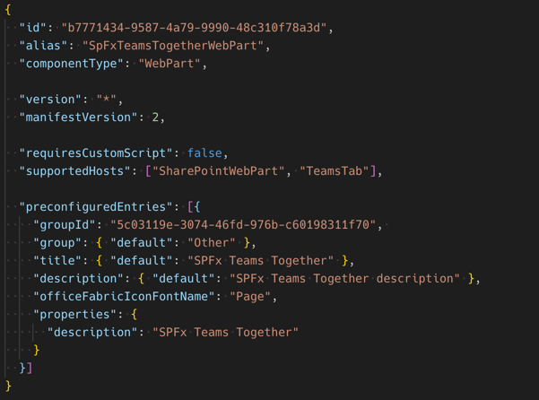
Specify SharePoint Framework Web Part can be Microsoft Teams Tab
Web part manifest property: supportedHosts
Web parts in SharePoint: SharePointWebPart
Tabs in Microsoft Teams: TeamsTab

Slide 24
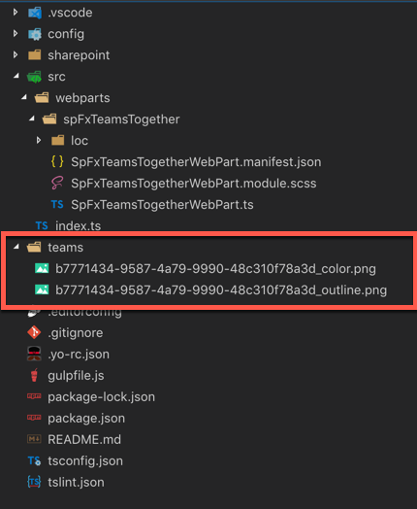

Create Microsoft Teams Tab Images
Default Microsoft Teams tab icon

Slide 25
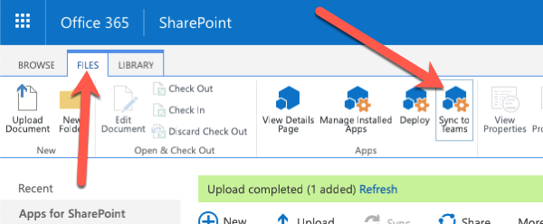
Create Microsoft Teams App manifest
Tells Microsoft Teams about the app:
Name and location of images
Name and description of application
”About” and metadata for application
Location of underlying application
SharePoint Framework web parts as Teams Tabs – already have most of the information in the SharePoint component’s manifest
SharePoint creates & deploys Microsoft Teams manifest automatically
Manual process performed by within SharePoint’s App Catalog
Dynamically creates the Microsoft Teams app manifest
Zips up manifest + images
Deploys to Microsoft Teams store
Notes:
The Microsoft Teams app manifest tells Microsoft Teams about your custom app. It contains the name and location of the images, name and description of the tabs, the location of the application, and other metadata about the app.
When you use a SharePoint Framework client-side web part as a tab, you have the option to create the app manifest yourself, or to let SharePoint create it for you.
After uploading and deploying the SharePoint package to the SharePoint App Catalog, you'll notice a **Sync to Teams** button in the ribbon when you select the package.
When you select the **Sync to Teams** button, SharePoint will create the Microsoft Teams app package and upload it to your tenant's Microsoft Teams store. The Microsoft Teams app package contains the tab's images and the manifest file.
If a manifest file is present in your **./teams** folder, SharePoint will use it. If it doesn't exist, SharePoint will create one automatically.

Slide 26
Overview
Custom Microsoft Teams Tab Configuration Options
Configure Once at Install
Edit Configuration in the Future
Notes:
In this unit, you'll learn how to configure your SharePoint Framework client-side web part's settings when its used as a tab in Microsoft Teams.

Slide 27
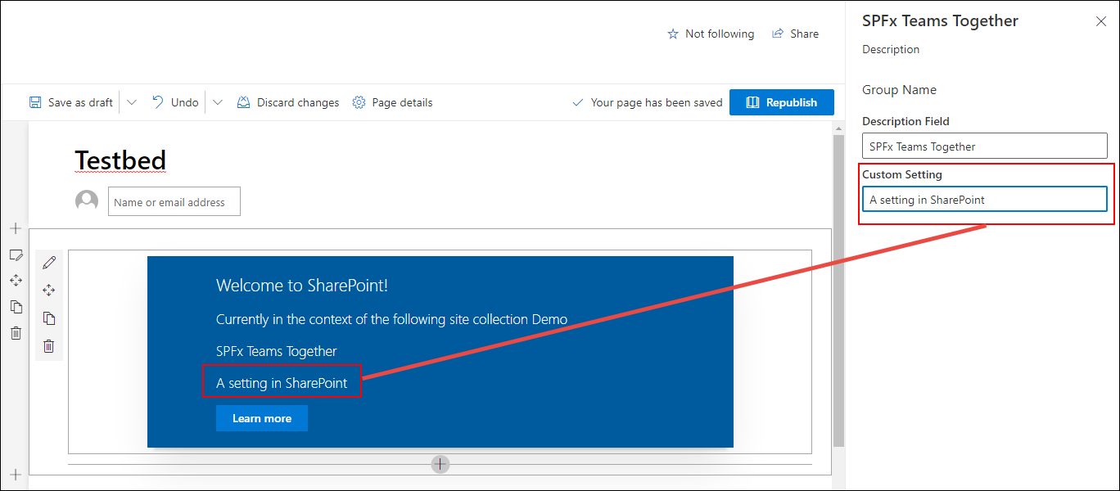
Custom Microsoft Teams Tab Configuration Options
SharePoint Framework web parts have public properties
Public properties can be made editable via the property pane
SharePoint page must be in edit mode to edit properties
User must have edit rights to the page to access the property pane
Notes:
SharePoint client-side web parts can have public properties. Developers can expose these properties to form controls within the SharePoint property pane for users to edit.
The property pane is only available when the page is in edit mode and only after a user has selected the edit control on the web part. The current user must also have access to edit the page in order to modify the settings on the web part.

Slide 28
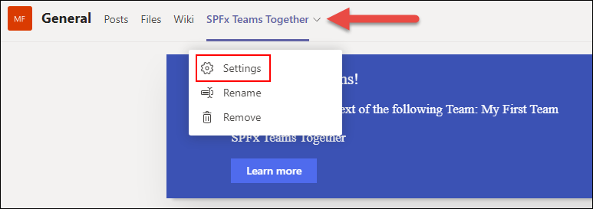
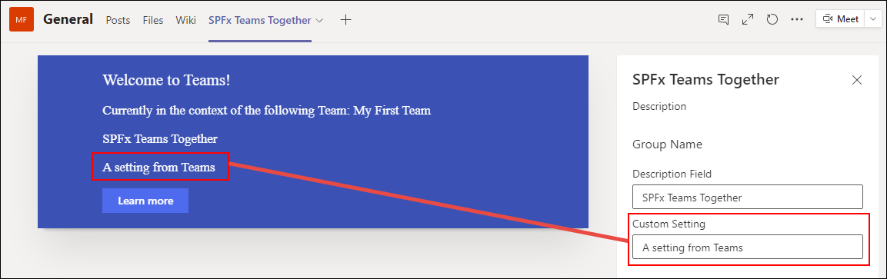
Property Pane Exposed in Microsoft Teams
Web Part property pane displayed when SPFx web part installed as a tab in a Microsoft Teams team
Accessible via the tab context menu Settings option
Notes:
The properties, called *settings*, on a tab in Microsoft Teams can also be modified by a user. To modify a tab's settings, select the tab's context menu and select the **Settings** option.
When the **Settings** menu option is selected, Microsoft Teams tabs launch a dialog that the tab that the developer implements.
However, when a web part is used as a Microsoft Teams tab, the tab is loading a SharePoint page that's hosting the client-side web part. When the **Settings** menu item is selected in teams, instead of opening a dialog, Microsoft Teams notifies SharePoint the page is now in edit mode. SharePoint's native property pane experience is then used to display edit the web part's public properties:

Slide 29
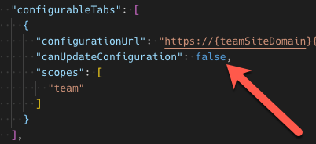
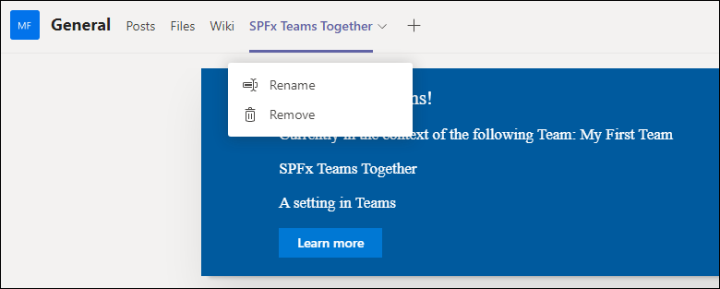
Configure Settings – Edit Only on Install
Developers optionally set property in Microsoft Teams app manifest to only allow SPFx web part properties to be set when tabs installed
Notes:
Users who have the necessary permissions can always edit SharePoint Framework client-side web parts, including immediately after they are added to the page and any point in the future.
Microsoft Teams tabs differ from web parts in that the settings experience is displayed once when the tab is added to a channel and optionally in the future. This enables someone who has access to add a tab to a channel to modify the settings, but can optionally block tab users from modifying the settings at a later date.
Developers can control this setting for the tab in the Microsoft Teams app manifest file.
The tab's `canUpdateConfiguration` property is set to `true` by default, but you can override this and set it to `false`.
When set to `false`, the settings page is only displayed immediately before the tab is added to the channel. In this scenario, the **Settings** button is not present on the tab's context menu:

Slide 30
Overview
Understand SPFx-Based Microsoft Teams Tabs
SharePoint Context
Microsoft Teams Context
Notes:
In this unit, you'll learn how to conditionally display information depending if the SharePoint Framework client-side web part is running in a SharePoint or Microsoft Teams environment.

Slide 31
SharePoint Framework & Microsoft Teams Context
SharePoint Framework Web Parts have access to the current page context
Provide access to the current page, site and site collection
SharePoint Framework v1.8.0 introduced the Microsoft Teams context object
this.context.microsoftTeams
SharePoint Framework 1.10.0 replaced Microsoft Teams context object with
this.context.sdks.microsoftTeams
Use the presence of the Microsoft Teams context to determine if web part is running in SharePoint or Microsoft Teams
Notes:
All SharePoint components, including client-side web parts, have access to the current context. The context, available from the `this.context` object, gives your components access to details about the page the component is running on.
Your component can use the page's context, accessible from the `this.context.pageContext` object, to get information about the current site site collection, site, page, and user.
Microsoft introduced a new context in the SharePoint Framework v1.8 release when they added support for deploying client-side web parts as Microsoft Teams tabs. The `this.context.microsoftTeams` object is a reference ot the `microsoftTeams` object available in the **\@microsoft\teams-js** package.
A client-side web part can detect if it is running in SharePoint or Microsoft Teams by checking if the `microsoftTeams` object is set to a value or is undefined. If it is `undefined`, then the component is not running in Microsoft Teams.

Slide 32
Working with the Microsoft Teams Context
let title: string = '';
let subTitle: string = ‘’;
let siteTabTitle: string = '';
if (this.context.sdks.microsoftTeams) {
// We have teams context for the web part
title = "Welcome to Teams!";
subTitle = "Building custom enterprise tabs for your business.";
siteTabTitle = "We are in the context of following Team: " +
this.context.sdks.microsoftTeams.context.teamName;
}
else {
// We are rendered in normal SharePoint context
title = "Welcome to SharePoint!";
subTitle = "Customize SharePoint experiences using Web Parts.";
siteTabTitle = "We are in the context of following site: " +
this.context.pageContext.web.title;
}
…
<span className="${ styles.title }">${title}</span>
<p className="${ styles.subTitle }">${subTitle}</p>
<p className="${ styles.description }">${siteTabTitle}</p>
<p className="${ styles.description }">Description property value - ${escape(this.description)}</p>
Notes:
Let's look at how your component can work with the Microsoft Teams context.

Slide 33
Demo Extending Microsoft Teams with SharePoint Framework Web Parts

